Slide 1
STEM CELL THERAPY
IN
CORONARY ARTERY DISEASE
Sreeith V

Slide 2
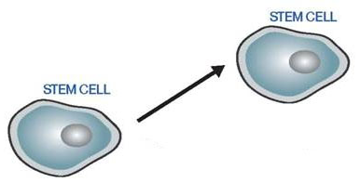
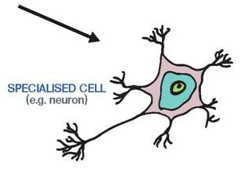
What are stem cells ?
Self - renew to make more stem cells
Differentiate into a specialised cell type
Notes:
This slide explains the basic properties of stem cells and introduces the concept of classification based on potency.

Slide 3
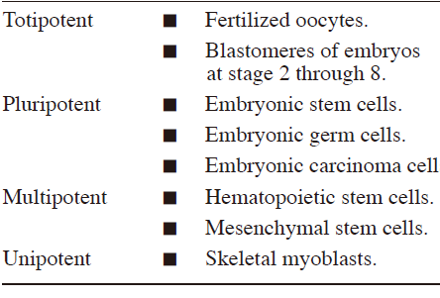

Slide 4

Present uses
Blood malignancies
Parkinsonism
Thalassemia
Type I DM
Cardiology
Osteoarthritis
Spinal cord injuries

Slide 5
Use in cardiology
Heart failure
Ischemic and non ischemic
Acute and chronic

Slide 7
Mechanisms of beneficial effects
Transdifferentiation
Cell fusion
Paracrine effect
Angiogenesis
Dedifferentiation.

Slide 8
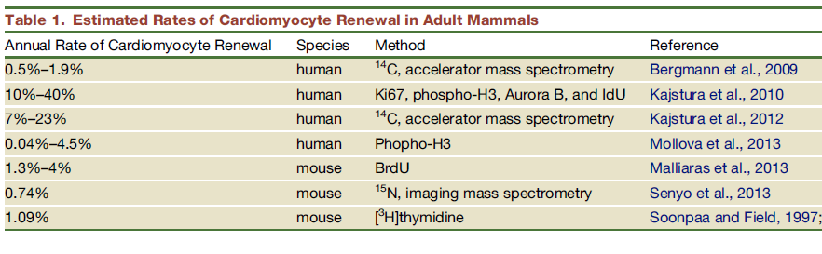

Slide 9
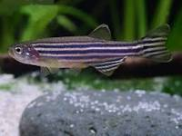
Dedifferentiation
Zebrafish have been found to fully regenerate the heart after a 20% left ventricular resection
In human heart its role is contraversial
Remodeling and dedifferentiation of adult cardiomyocytes during disease and regeneration.Szibor M, Pölin J, Warnecke H, Kubin T, Braun T.Cell Mol Life Sci. 2014 May;71(10):1907-16

Slide 10
Mode of delivery of cells
Intramyocardial
Intracoronary
Catheter-guided endoventricular
Transvenous injection through coronary sinus
Embedding the cells into a biocompatible matrix
Depends on the cell size.
  Skeletal myoblast transplantation is precluded by intracoronary injection because of the cell size.

Slide 11
Cells used
Embryonic stem cells
Autologous whole bone marrow (AWBM)
  Hematopoeitic stem cells
  Mesenchymal stem cells
  Endothelial proliferator cells
Skeletal myoblasts
Fetal cardiomyocytes
Cardiac stem cells
Induced pleuripotent stem cells

Slide 12
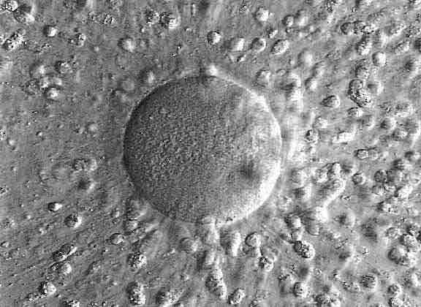
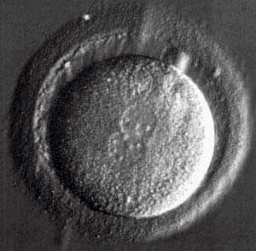
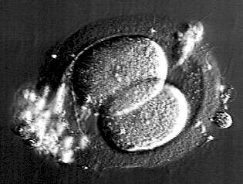
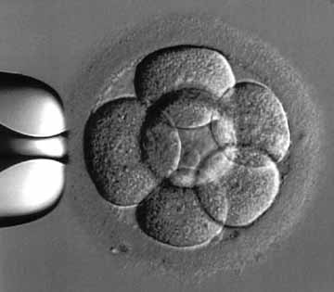
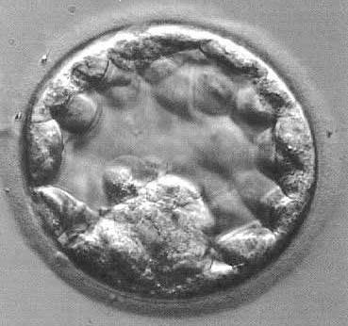
Embryonic stem cells
Donated excess IVF embryos
Inner cell mass
egg
fertilised egg
2-cell
8-cell
blastocyst
Day 0
Day 1
Day 2
Day 3
Day 6
Images from www.advancedfertility.com
Notes:
12
DEBATE

Slide 13
Esc –problems
Allograft rejection
Immunosuppression
Ability to form teratoma before they differentiate.
Ethical considerations

Slide 14
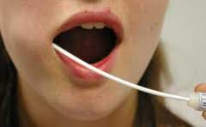
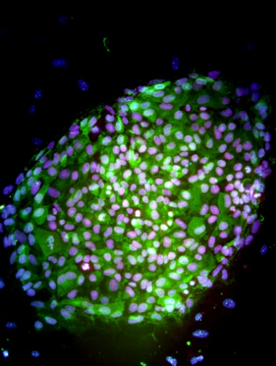
Induced pluripotent stem cells
Starting cells from donor tissue
Derived from adult cells in 2007
Can create stem cells directly from a patient for research
Autologous
Many cell types derived from iPSCs are incompletely differentiated compared to the mature cell.
Induced change in gene expression
iPS Cells
Pluripotent stem cells

Slide 15
Fetal cardiomyocytes
Formation of nascent intercalated disks between grafted fetal cardiomyocytes and host myocardium.
Improves heart function.
Leor J, Patterson M, Quinones MJ, Kedes LH, Kloner RA Transplantation of fetal myocardial tissue into the infarcted myocardium of rat. A potential method for repair of infarcted myocardium? Circulation 1996; 94: II332-6.

Slide 16
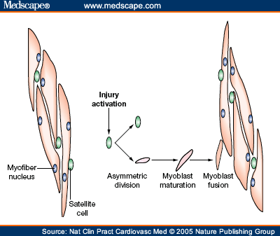
Skeletal myoblasts
Also called satellite cells
Normally reside under the basement membrane of skeletal muscle
Early -committed muscle cells instead of true stem cells
In animal studies - differentiate into muscle cells and engraft to the host myocardium with resulting functional improvement
Taylor DA, Atkins BZ, Hungspreugs P, et al. Regenerating functional myocardium: improved performance after skeletal myoblast transplantation. Nat Med 1998; 4: 929-33.

Slide 17
Skeletal myoblasts
Arrhythmia
Prolonged culture time
Early decay of cell survival
Low rate of cell engraftment over time.
Soliman AM, Krucoff MW, Crater S, et al. Cell location may be a primary determinant of safety after myoblast transplantation into the infarcted heart. J Am Coll Cardiol 2004;

Slide 18
Bone marrow-derived stem cells:
The cell type most widely used
Easy accessibility
Autologous origin
Multiple subpopulations of cells
Transdifferentiate into both myocardial and vascular cells.
Sub types - 3
Orlic D, Kajstura J, Chimenti S, et al: Bone marrow cells regenerate infarcted myocardium. Nature 410:701, 2001

Slide 19
Peripheral mononuclear cells
Peripheral blood-derived
Mononuclear cells
Apharesis
After stimulation with cytokines
Recently completed CSA trail used
Tatsumi T, Ashihara E, Yasui T, et al. Intracoronary transplantation of non-expanded peripheral blood-derived mononuclear cells promotes improvement of cardiac function in patients with acute myocardial infarction. Circ J 2007; 71: 1199-207.

Slide 20
Hematopoietic stem cells
c-kit+
Sca-1+
CD34lo
CD 38hi

Slide 21
Mesenchymal stem cells
Prototypically found in the bone marrow,
Differentiate into, chondrocytes and adipocytes etc
Co-culture with cardiomyocytes or exposure to 5-azacytidine, differentiate into cardiomyocyctes in vitro.
Differentiate into endothelial cells when cultured with vascular endothelial growth factors
Davani S, Marandin A, Mersin N, et al. Mesenchymal progenitor cells differentiate into an endothelial phenotype, enhance vascular density, and improve heart function in a rat cellular cardiomyoplasty model. Circulation 2003; 108: 253-8.

Slide 22
Mesenchymal Stem Cells
Able to evade immune responses
Innate ability to overcome the rejection.
Possibility of nonautologous transplantation

Slide 23
Adipose tissue Mesenchymal S C
Isolation of adequate numbers of cells without requiring expansion.
Mazo M, Gavira JJ, Pelacho B, Prosper F: Adipose-derived stem cells for myocardial infarction. J Cardiovasc Transl Res 4:145, 2011.

Slide 24
Second-Generation Cell
Multipotent adult precursor cells (MAPCs)
  Dermis
Cardiopoietic MSCs
  MSC cultured with a cocktail of cardiopoietic cytokines
More primitive
Greater differentiation capacity,

Slide 25
Endothelial progenitor cell
Functional precursors of endothelial cells.
CD34+,
AC 133+,
c-kit
VEGF2
Isolated from either the bone marrow or the peripheral blood
EPCs home into ischemic foci and contribute Angiogenesis
Kawamoto A, Gwon HC, Iwaguro H, et al. Therapeutic potential of ex vivo expanded endothelial progenitor cells for myocardial ischemia. Circulation 2001; 103: 634-7.

Slide 26
Cardiac stem cells
First found in 2002
Hierlihy et al..
Hierlihy AM, Seale P, Lobe CG, Rudnicki MA, Megeney LA.The post-natal heart contains a myocardial stem cell population. FEBS Lett 2002; 530: 239-43.

Slide 27
Cardiac stem cells
Bears the c-kit receptor
Atrial appendage
Endomyocardial biopsy
Collagenase-digested tissue yields c-Kit cells
Purified by antigenic panning
expanded in culture
Regenerate
  Contractile myocytes
  Vascular cells
Beltrami AP, Barlucchi L, Torella D, et al. Adult cardiac stem cells are multipotent and support myocardial regeneration. Cell 2003 ; 114: 763-76.

Slide 28
Combination of stem cell
Human cardiac c-kit cells had greater efficacy when mixed with MSCs in reducing infarct size
Hatzistergos KE, Quevedo H, Oskouei BN, et al: Bone marrow mesenchymal stem cells stimulate cardiac stem cell proliferation and differentiation. Circ Res 107:913, 2010.

Slide 29
Types of research
Basic
  Biologic
  Animal
Translational research
  Clinical trail

Slide 30
SKELETAL MYOBLAST

Slide 31
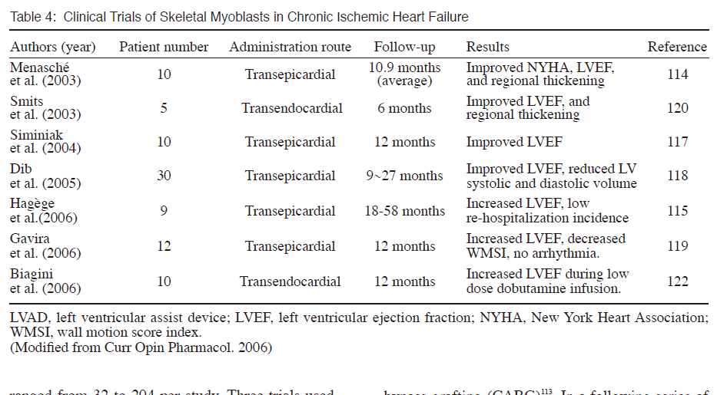

Slide 32
MYOHEART™ (Myogenesis Heart Efficiency and Regeneration Trial)
A Phase I
Open-Label
Non-Randomized
Dose EscalatioN
Multi Center
Autologous Skeletal Myoblast
Congestive Heart Failure Patients
Post Myocardial Infarction(s)
With Previous Placement of ICD

Slide 33
MARVEL
Randomized
Placebo-controlled
class II to IV HF and ejection fraction <35%.
Primary end points were frequency of serious adverse events (safety)
Changes in 6-minute walk test and Minnesota Living With HF score (efficacy).
330 patients intended for enrollment
23 were randomized before stopping the study for financial reasons.
Ventricular tachycardia responsive to amiodarone was more frequent in myoblast-treated patients:
Without significant changes in Minnesota Living With HF scores.

Slide 34
Magic- short term
Autologous skeletal myoblasts
Ischaemic cardiomyopathy
CABG +LVD
Improved left ventricular (LV) remodelling.

Slide 35
Magic- long-term
The LV function did not improve
Long-term LV volumes in the high-dosage group were reduced.
During the follow-up, there were also no additional arrhythmogenic incidences. .

Slide 36
BONE MARROW

Slide 37
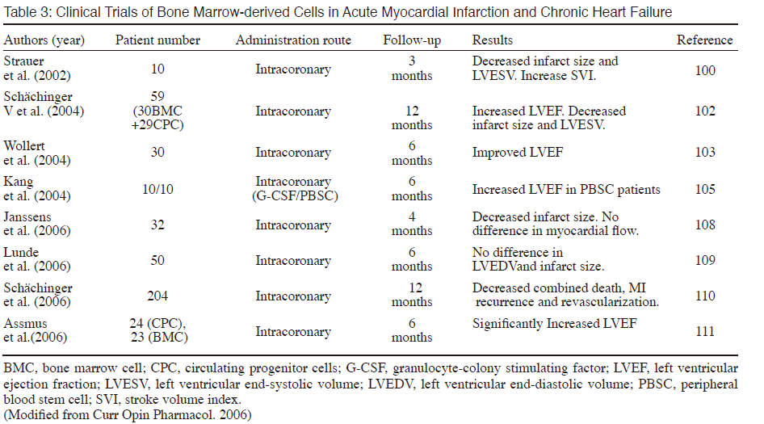

Slide 38
TOPCARE-AMI
RCT
AMI
Intracoronary transplantation
Compared BMSCs and circulating progenitor cells
No significant differences between these two groups.
Similar increases in left ventricular ejection fraction
5 Year follow up recently published
Schächinger V, Assmus B, Britten MB, et al. Transplantation of progenitor cells and regeneration enhancement in acute myocardial infarction: final one-year results of the TOPCARE-AMI Trial. J Am Coll Cardiol 2004; 44: 1690-9.

Slide 39
BOOST
RCT Placebo
60 patients
AMI after coronary angioplasty
Intracoronary injection of BMPCs
5-7 days post-AMI
Significant improvement of LVEF at 6 months follow-up,
Compared with OMT
Wollert KC, Meyer GP, Lotz J, et al. Intracoronary autologous bone-marrow cell transfer after myocardial infarction: the BOOST randomised controlled clinical trial. Lancet 2004; 364: 141-8.

Slide 40
BOOST
The LVEF improvement was not sustained at 18 M
evaluated by MRI
There was no statistically significant difference in the incidence of arrhythmia

Slide 41
STEMMI
RCT placebo
Efficacy of subcutaneous G-CSF injections
Within 6 days of AMI
LVEF
No difference
Ripa RS, Jørgensen E, Wang Y, et al. Stem cell Mobilizationinduced by subcutaneous granulocyte-colony stimulating factor to improve cardiac regeneration after acute Stelevation myocardial infarction: result of the double-blind, randomized, placebo-controlled stem cells in myocardial infarction (STEMMI) trial. Circulation 2006; 113: 1983-92.

Slide 42
BAMI -Phase iii
RCT placebo
STEMI
Successful acute reperfusion
EF≤ 45%
Significant RWMA 2 to 6 days after reperfusion therapy
Open coronary artery suitable for cell infusion
EU funded
Queen Mary University of London
2018
3000

Slide 43
PERFECT Phase III
German, Phase III, multicenter trial
LVF
CABG
Intramyocardial bone marrow stem cell injection

Slide 44
MSC

Slide 45
The PROMETHEUS Trial
RCT
MSCs were transepicardially
After CABG procedure
in areas of the myocardium not deemed fit for surgical revascularization.

Slide 46
The PROMETHEUS Trial
Six patients
MRI was used to measure scar, perfusion, wall thickness and contractility at baseline, 3, 6 and 18 months
Compared structural and functional recovery in
  regions that received MSC injections alone,
  revascularization alone,
  or neither.
Favourable result

Slide 47
C cure
Cardiopoietic MSCs,
IHD with HF
Intramyocardial administration
Increased ejection fraction,
Reduced end-systolic volume,
Improved the 6-minute walk distance
Bartunek J, Behfar A, Dolatabadi D, et al: Cardiopoietic stem cell therapy in heart failure: TheC-Cure Cardiopoietic stem Cell therapy in heart failURE) multicenter randomized trial with lineage-specified biologics. J Am Coll Cardiol 61:2329, 2013

Slide 48
ORISIS- completed this month
PHASE II RCT OF MSC
Male or female between 21 and 85 years old,
First heart attack within 7 days prior to randomization and drug infusion
Baseline LVEF 20-45%
Hemodynamically stable within 24 hours prior to randomization
Adequate pulmonary function

Slide 49
TAC HFT
PHASE 2 RCT
Chronic ischemic LVD secondary to MI.
Be a candidate for cardiac catheterization.
Been treated with appropriate OMT
Ejection fraction less than or equal to 50%.
Infused
  Autologous human mesenchymal cells (hMSCs)
  Autologous human bone marrow cells (hBMCs)
  Placebo

Slide 50
POSEIDON trial: After MI
PHASE 1/2 RCT
Autologous or allogeneic bone marrow–derived MSCs,
Transendocardial injection – in 2 months
Reduced infarct size by one third
Logic- Allogenic easily available
(From Hare JM, Fishman JE, Gerstenblith G, et al: Comparison of allogeneic vs. autologous bone marrow–derived mesenchymal stem cells delivered by Transendocardial injection in patients with ischemic cardiomyopathy: the POSEIDON randomized trial. JAMA 308:2369, 2012.)

Slide 51
Cardiac stem cell

Slide 52
CADUCEUS trial
Autologous CSC
Endomyocardial biopsy specimens
Infused via the intracoronary route
17 patients with left ventricular dysfunction
1.5 to 3 months after myocardial infarction
Eight patients were followed as routine-care control patients.

Slide 53
CADUCEUS
No significant safety concerns.
Decreased scar size
Increased viable myocardium
Improved regional function of infarcted myocardium.

Slide 54
SCIPIO trial
PHASE 1 RCT
33 patients
Autologous cardiac c-kit–positive cells
Right atrial appendage
During CABG
Subsequent intracoronary infusion of these CSCs produced reduced infarct size and increased ejection fraction
AR, Beache GM, Loughran GH, et al: Administration of Cardiac stem cells in patients with ischemic cardiomyopathy The SCIPIO trial: Surgical aspects and interim analysis of myocardial function and viability by magnetic resonance. Circulation 126(11 Suppl):S54, 2012; and Bolli R, Chugh AR, D’Amario D, et al: Cardiac stem cells in patients with ischaemic cardiomyopathy (SCIPIO): initial results of a randomised phase 1 trial. Lancet 378:1847, 2011.)

Slide 55
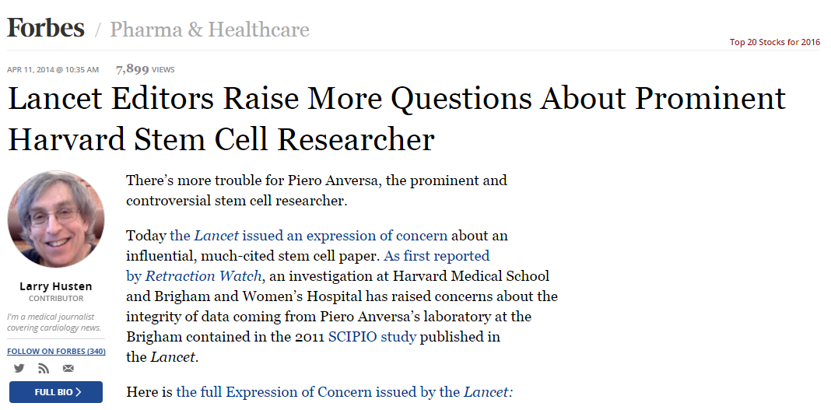

Slide 56
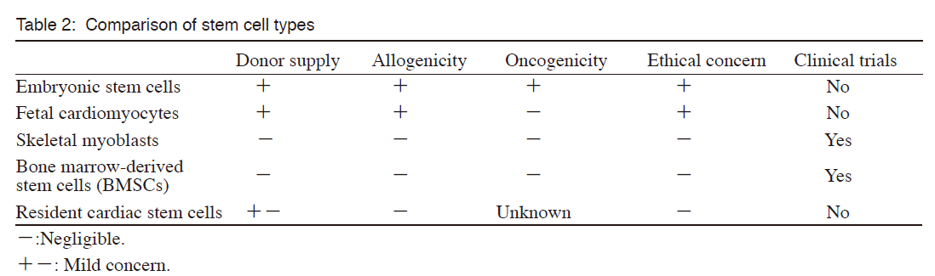

Slide 57
COCHRANE review 2015 a/c
Forty-one RCTs with a total of 2732 participants
There is insufficient evidence for a beneficial effect of cell therapy for AMI patients.
However, most of the evidence comes from small trials that showed no difference in clinically relevant outcomes.
Further adequately powered trials are needed and until then the efficacy of this intervention remains unproven

Slide 58
COCHRANE review 2014 - c/c
BMSC treatment improves LVEF.
Unlike in trials where BMSC were administered following acute myocardial infarction (AMI), we found some evidence in chronic IHD and heart failure,
BMSC treatment improves LVEF.
Beneficial clinical effect in terms of mortality and performance status in the long term
Although the quality of evidence was low.

